Slide 1

Research Computing New User Seminar

Slide 2
Research Computing New User Seminar
Gerardo Hidalgo-Cuellar: gehi0941@Colorado.Edu
Website: www.rc.colorado.edu
Help: rc-help@colorado.edu
Slides: https://github.com/ResearchComputing/New_User_Seminar

Slide 3

Research Computing
Large scale beyond the desktop computing resources

Slide 4
Before We Begin
Goals
Basic resources Research Computing (RC) offers
How to get an account & log in
How to navigate Research Computing (RC)
How to run a job
Help!

Slide 5
Before We Begin
Goals
Basic resources Research Computing (RC) offers
How to get an account & log in
How to navigate Research Computing (RC)
How to run a job
Help!
Things to take note of
Confusing, ambiguous, highly nuanced concepts
Common mistakes or frustrations
Ask Questions!

Slide 6
Jargon
RC = Research Computing
HPC = High Performance Computing
<input> = your input (username, password, etc.), do not include <> when you write it

Slide 7


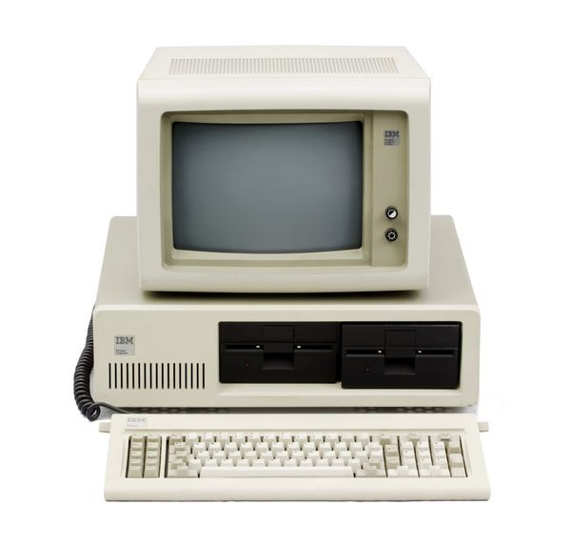
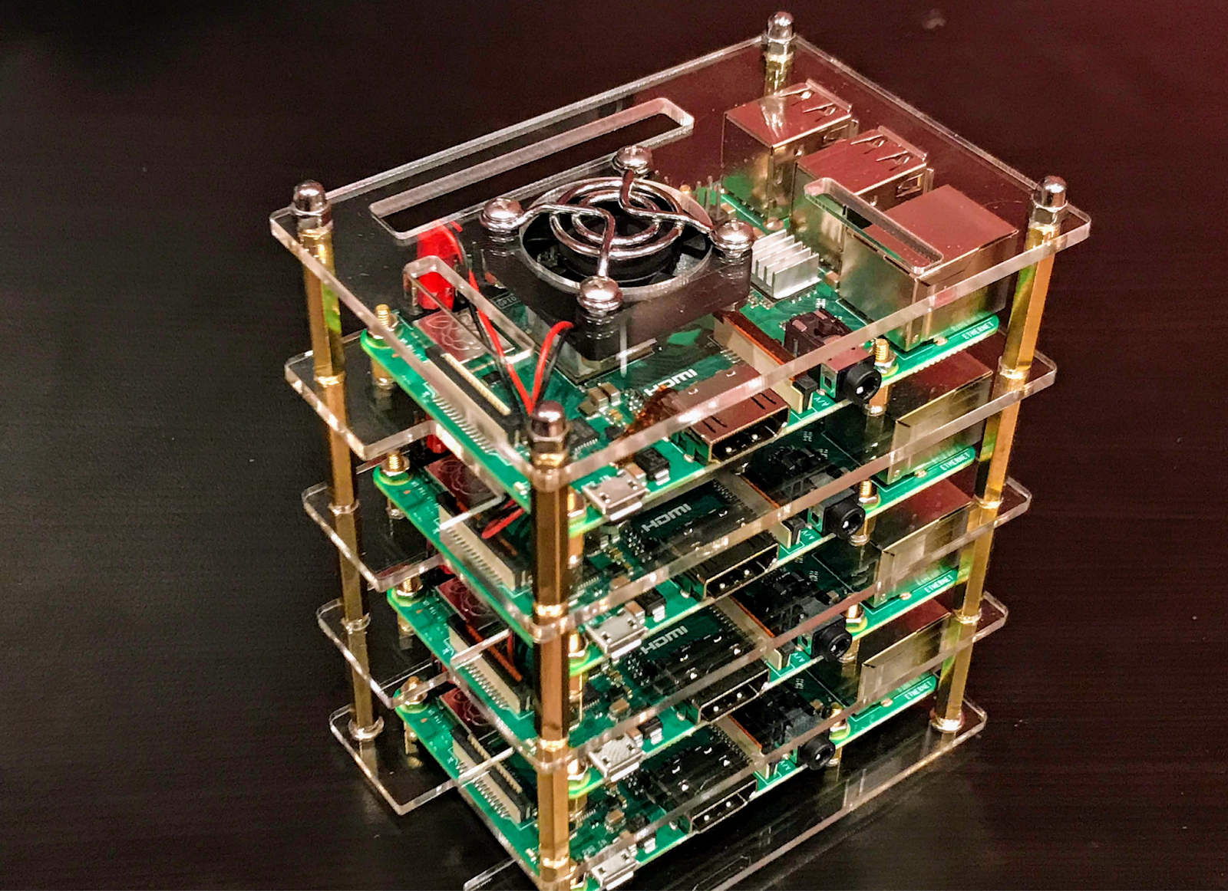

Why High Performance Computing (HPC)?
HPC
Personal Computers
Personal Data
Photos
Games
Applications...
Behavior analysis
Climate modeling
Molecular sciences
Early universe...
Notes:
Why would we even want HPC?
Many people come to RC with the recommendation of PI/Professors (not always) but it is sometimes difficult to understand the motivation of High Performance Computers.
Unlike PCs which deal with (generally) small amounts of data read/write, as researchers, you may have the necessity to read/write data potentially a thousand million times more than what you could expect on a Personal Computer
Introduce the concept of a node as being a small part of the aggregate whole
Using resources together in parallel to work on a problem - Puzzle analogy

Slide 8

High Performance Computing
Computer
Hardware
Submit Job
Management
service
Get Results
Storage
Notes:
As a user you want to a) submit a job (analysis to run) then, eventually b) get the results
Behind the scenes things can be broken down into 3 main parts
A management service that help distribute job loads because this is a shared resource
Hardware to actually perform the computation
Storage for software, system information, your data

Slide 9
What is Research Computing?
Provide services for researchers that include:
Large scale computing
Data storage
High speed data transfer
Data management support
Consulting & Training
We are likely best known for:
Summit Supercomputer
PetaLibrary Storage

Slide 10
Research Computing Services
Supercomputing Clusters
Storage
Gateways

Slide 11
Research Computing Services
Supercomputing Clusters
Summit, Blanca, (Alpine)
Storage
Core, PetaLibrary
Gateways
JupyterHub, EnginFrame, (CUmulus)

Slide 12
High Performance Computing
Computer
Hardware
Submit Job
Management
service
Get Results
Storage

Slide 13
CU Research Computing
Summit
(Alpine)
Blanca
Submit Job
Management
service
Core Storage
Get Results
PetaLibary

Slide 14
Summit Cluster
Free-access, NSF-funded supercomputer
450+ (mostly) compute nodes
Also have memory, and graphics nodes
Shared between CU, CSU, and Rocky Mountain Advanced Computing Consortium (RMACC)
Notes:
The Rocky Mountain Advanced Computing Consortium is a collaboration among academic and research institutions located throughout the intermountain states.

Slide 15
Blanca Cluster
Condo computing service
Buy-in Cluster
Compute and Graphics nodes available.

Slide 16
PetaLibarary
Service for:
Storage
Archive
Sharing of research data.
Available at a subsidized cost to any researcher affiliated with the University of Colorado Boulder.

Slide 17
How to Access RC Resources?
Get an account
Set up two factor authentication
(Inform us of any specific needs)
Log in
Create greatness (responsibly)

Slide 18
Getting an account
CU Boulder users and affiliates:
Request an account through the RC Account request portal
https://rcamp.rc.colorado.edu/accounts/account-request/create/organization
CSU Users:
Request an CSU eID if you don’t have one
Fill out account application form
Duo authentication
Then get an RC user account
https://www.acns.colostate.edu/hpc/summit-get-started/
RMACC Users:
Contact your local representative, if known. Email rc-help@colorado.edu
We’ll guide you through the process

Slide 19
Demo: Getting an Account
CU Boulder users and affiliates:
Request an account through the RC Account request portal
https://rcamp.rc.colorado.edu/accounts/account-request/create/organization

Slide 20
Two Factor Authentication
Provides an extra level of authentication
We are outside the firewall!
Valuable resources
Inviting, high-profile target
Lost time investigating/fixing
Duo
You will receive a Duo invitation when your RC account is created.

Slide 21
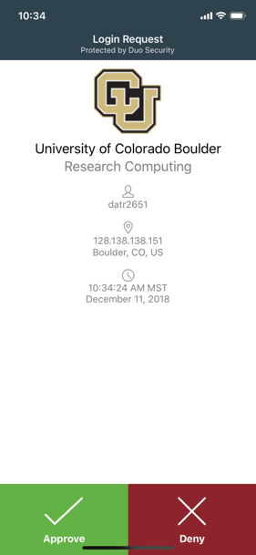
Duo Authentication
Most users use the Duo smartphone app
“Phone Call” is an alternatives
Physical code generator “token” available for $20

Slide 22
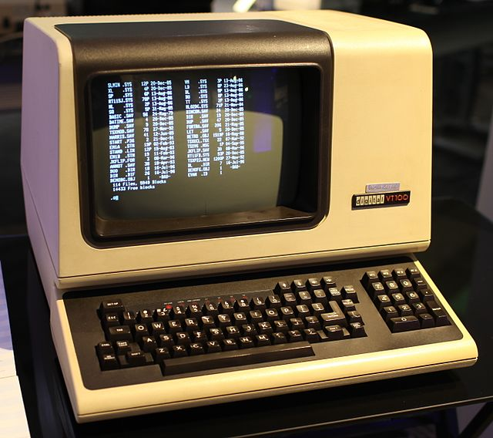
Terminal
Mac or Linux
Terminal application
Windows
PuTTY

Slide 23
Demo: Logging in
To login to an RC login node:
ssh <username>@login.rc.colorado.edu
Supply your IdentiKey password and your Duo app will alert you to confirm the login

Slide 24
Logging In
It’s important to note that you are NOT logging into any specific resource, Summit, etc.
When you log in, you land on our login nodes
From there, you can access our other resources

Slide 25
Node | File System
One computing server Physical hardware Work together in parallel | The basic tree-like layout From any node* you have access to the entire file system
/
d1
d2
d3
d4
f1
f2
Notes:
Nodes are used because there are different needs for hardware - some basic functionality, some very intensive functionality

Slide 26
Node | File System
One computing server Physical hardware Work together in parallel | The basic tree-like layout From any node* you have access to the entire file system
/
d1
d2
d3
d4
f1
f2
Notes:
Nodes are used because there are different needs for hardware - some basic functionality, some very intensive functionality

Slide 27
Nodes Types
Login
Compile
Compute
Computer
Hardware
Submit Job
Management
service
Get Results
Storage
Notes:
The network that we have separated into the different components for our overview are in fact run on separate distinct pieces of hardware working as a whole.

Slide 28
Nodes
Login | Compile | Compute
Where you start For editing code, job submission No heavy computation | Where you compile code, install packages Explore the Summit software environment Edit code, submit jobs No heavy computation | Where scheduled jobs run Intended for heavy computation
Ex. edit job script | Ex. Install python libs | Ex. Running Matlab

Slide 29
Demo: Exploring nodes
Once logged in:
ssh scompile
To log in to a compile (or head) node.
module avail
To check currently available software

Slide 30
File system map
/home/<user>
Node
/
/projects/<user>
Scratch space

Slide 31
File Structures
/home (2GB) | /projects (250GB) | Scratch (10TB)
Scripts, Code, Small, important files/directories Not for sharing files or job output | Code/files/libraries Software you are installing Sharing files Not for job output | Output from running jobs Large files/datasets Sharing files Not for long term storage
Ex .bashrc | Ex. Shared job scripts | Ex. Data

Slide 32
Demo: Exploring the Filesystem
Once logged in:
cd /home/<user>
cd /projects/<user>
cd /scratch/summit/<user>
To navigate to your different directories

Slide 33
Using Research Computing
We have logged on
We have explored nodes and filesystem
But how do we actually use the computing resources?

Slide 34
The fundamental “job”
What is a “job”?
Jobs are scripted packages of work for the cluster to perform on
Batch jobs
Submit job script which will be executed when resources are available
Create or modify a script containing information about the job
Submit the job file to a queue
Interactive jobs
Work interactively at the command line of a compute node
Notes:
Cookie analogy** describing a batch job
Limitations of interactive jobs

Slide 35
Job Scheduling
On a supercomputer, jobs are scheduled rather than just run instantly
Shared system
Jobs are put in a queue until resources are available
Simple Linux Utility for Resource Management (SLURM)
Keeps track of what nodes are busy/available, and what jobs are queued or running
Tells the resource manager when to run which job on the available resources

Slide 36
Your first job
/home/<user>
Where to put it?
How to write it?
How to run it?
/projects/<user>
Scratch space
Notes:
demo

Slide 37
Job Script: 3 main parts
Directives
Specify resource requirements
Software
jobs run on a different node than from where you ran
software that is needed must be loaded via the job script
User scripting
the actual user scripting that will execute when the job runs

Slide 38
Directive Options
http://slurm.schedmd.com/sbatch.html
#SBATCH <options> sbatch <options>
Allocation: --account=<account_no>
Partition: --partition=<partition_name>
Sending emails: --mail-type=<type>
Email address: --mail-user=<user>
Number of nodes: --nodes=<nodes>
Number of tasks: --ntasks=<processes>
Quality of service: --qos=<qos>
Reservation: --reservation=<name>
Wall time: --time=<wall time>
Job Name: --job-name=<jobname>
FYI: You do NOT actually type <> above – this designates something specific you as a user must enter about your job

Slide 39
Writing a Job: Hostname
Submit a slurm job with the following instructions:
The job will be submitted from a bash script named hostname_summit.sh
The job should run the Unix “hostname” command
The job will run on 1 node
We will request 1 minute wall time
Run using “testing” QOS
Run on the shas-testing partition
Output should contain job #

Slide 40
Demo: Writing Hostname

Slide 41
Demo: Writing Hostname
#!/bin/bash
#SBATCH --nodes=1 # Number of requested nodes
#SBATCH --time=0:01:00 # Max wall time
#SBATCH --qos=testing # Specify QOS
#SBATCH --partition=shas-testing # Specify Summit haswell nodes
#SBATCH --output=hostname_%j.out # Rename standard output file
# purge all existing modules
module purge
hostname

Slide 42
Submitting a Job
Load up the slurm module (probably not needed)
module load slurm/summit
Submit the job:
sbatch hostname_summit.sh
Check output

Slide 43
Help! I’m stuck, where do I go next?
We’ve got your back:
Documentation: https://curc.readthedocs.io/en/latest/
Trainings: https://www.colorado.edu/crdds/what-we-do/education-training
Email: rc-help@colorado.edu

Slide 44
Review
Goals
Basic resources RC offers
How to get an account & log in
How to navigate RC
How to run a job
Help!

Slide 45
Questions

